Slide 1
Linear Regression

Slide 2
What is Linear Regression?
Before jumping to linear regression let us go back and see what is Regression. Regression is a method of modelling a target value based on independent predictors. This method is mostly used for forecasting and finding out cause and effect relationship between variables. Regression techniques mostly differ based on the number of independent variables and the type of relationship between the independent and dependent variables.

Slide 3
Now Simple linear regression is a type of regression analysis where the number of independent variables is one and there is a linear relationship between the independent(x) and dependent(y) variable. The red line in the below graph is referred to as the best fit straight line. Based on the given data points, we try to plot a line that models the points the best. The line can be modelled based on the linear equation.

Slide 4
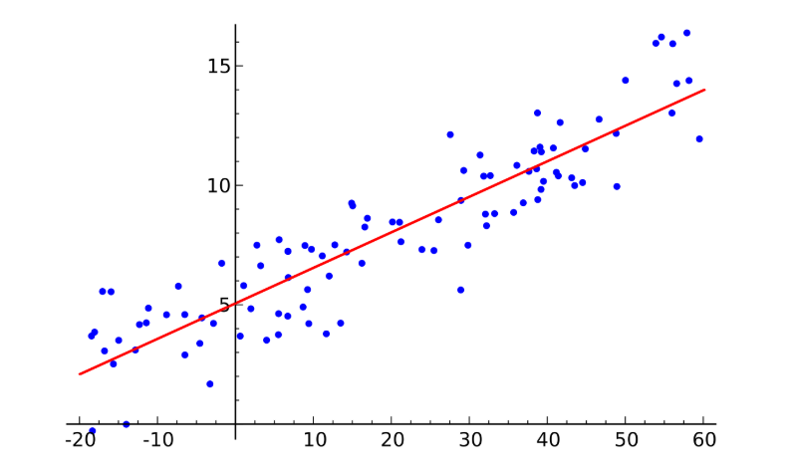
Image src - wikipedia

Slide 5
Example
Consider Height and weight example, say height be our dependent variable(y-axis) and weight being our independent variable(x-axis). We want to predict the value of height based on the value of the weight of the person using linear regression. What is the equation of a line => y = mx + c or y = a_0 + a_1*x
So here we will predict height using the line equation => height = a_0 + a_1*weight
a_0 being the intercept and a_1 being the weight

Slide 6
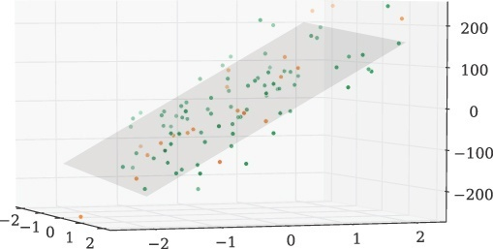
In Multiple linear regression we model the linear relationship between the independent variables and the dependent variable
Example equation => y = a_0 + a_1*x1 + a_2*x2 + a_3*x3 + ….
Image src - https://static.commonlounge.com/fp/original/wtwk9VvJDsqBlhIWdg2wDAZe51520496527_kc

Slide 7
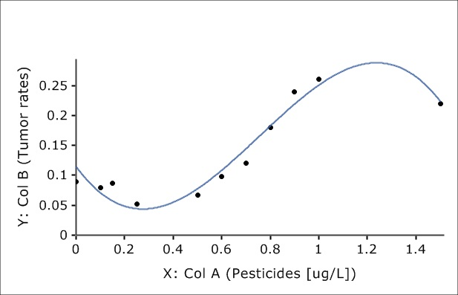
Non-linear equation example => y = a_0 + a_1*x + a_2*x^2 + a_3*x^3 + ….
Image source - https://maxstat.de/images/Dokumentation/drex_nonlinear_regression_custom_2.png

Slide 8
Cost Function
The cost function helps us to figure out the best possible values for a_0 and a_1 which would provide the best fit line for the data points. Since we want the best values for a_0 and a_1, we have this as a minimization problem where we would like to minimize the error between the predicted value and the actual value.

Slide 9
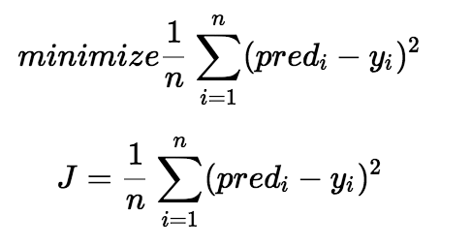
pred_i = a_0 + a_1*x
x is the input parameters,
y_i is the actual label(target)
n is number of data points

Slide 10
We choose this function(mentioned in the previous slide) to minimize. The difference between the predicted values and ground truth measures the error difference. We square the error difference and sum over all data points and divide that value by the total number of data points. This provides the average squared error over all the data points. Therefore, this cost function is also known as the Mean Squared Error(MSE) function. Now, using this MSE function we are going to change the values of a_0 and a_1 such that the MSE value settles at the minima.

Slide 11
Gradient Descent
The next important concept needed to understand linear regression is gradient descent. Gradient descent is a method of updating a_0 and a_1 to reduce the cost function(MSE). The idea is that we start with some values for a_0 and a_1 and then we change these values iteratively to reduce the cost. Gradient descent helps us on how to change the values.

Slide 12
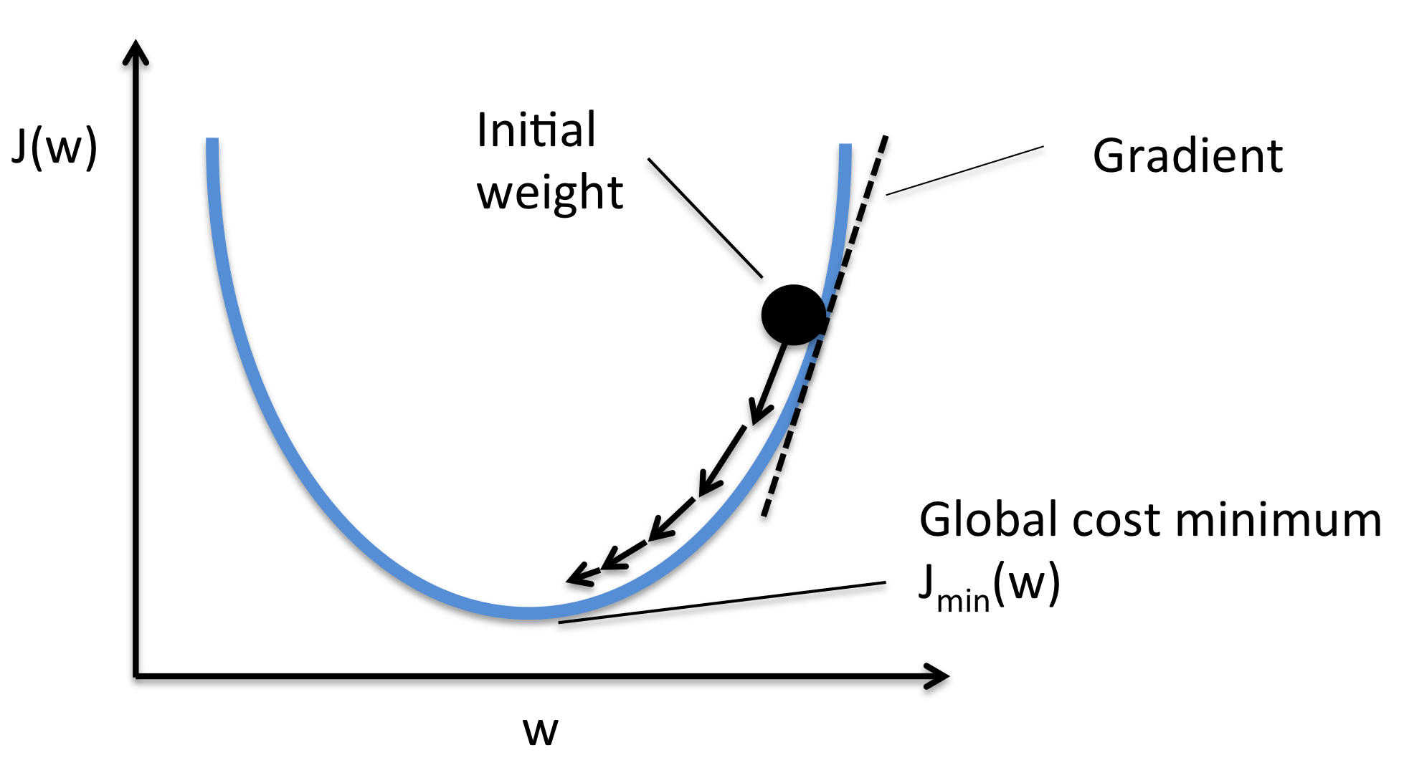
Img src - https://rasbt.github.io/mlxtend/user_guide/general_concepts/gradient-optimization_files/ball.png

Slide 13
To understand about it more, let's consider a U shape pit and you are standing at the top point of the pit and you want to reach the bottom most point of the pit. Now there is one thing, the size of the step you are taking will be consistent. So, there will be two cases, first is that if you take small steps you will reach the bottom point but it will take longer time to reach there, but if you take larger steps then there is a chance that
There is a catch, you can only take a discrete number of steps to reach the bottom. If you decide to take one step at a time you would eventually reach the bottom of the pit but this would take a longer time. If you choose to take longer steps each time, you would reach sooner but, there is a chance that you could overshoot the bottom of the pit and not exactly at the bottom. In the gradient descent algorithm, the number of steps you take is the learning rate. This decides on how fast the algorithm converges to the minima.

Slide 14
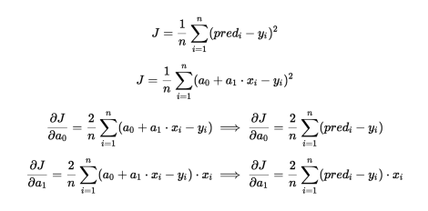

Slide 15
